Slide 1


ISTM 6202 Relational Database
Team 5 CVS Drive-Thru COVID-19 Vaccine System
by
Sai Sohila Mantena , Anisha Mullapudi, Rakesh Singh, Shilpy Vohra
1

Slide 2
Agenda
1.
Business Problem
2.
Section I – As-Is System
3.
Section I – As-Is Business Process Map & ERD
4.
Section II – Proposed Solution
5.
Section II – Proposed Business Process Map & ERD
Section II – Data Entity Matrix
6.
7.
Section III – DB Implementation (Table Creation, Data Insert & SQL Queries)
8.
Conclusion & Closure
2
Notes:
Shilpy

Slide 3

Business Problem
Background
CVS Health System
Minute Clinic
Business Problem
Improvise the I.T System to cater essential requirement of vaccinating consumers
Improving the current system to accommodate new business opportunity
The current system has a scope to accommodate the new opportunity effectively
Currently there is no system in place to support drive-thru vaccinations
3
Notes:
Shilpy

Slide 4

Section I – As-IS I.T System
Current IT Systems
The current business process map shows how CVS’s online reservation system functions. There are three swim lanes which are consumers, the online department, and the health team members.
* As-Is Business Process Map and As-Is Database ERD is shown on next slides
4
Notes:
Rakesh

Slide 5
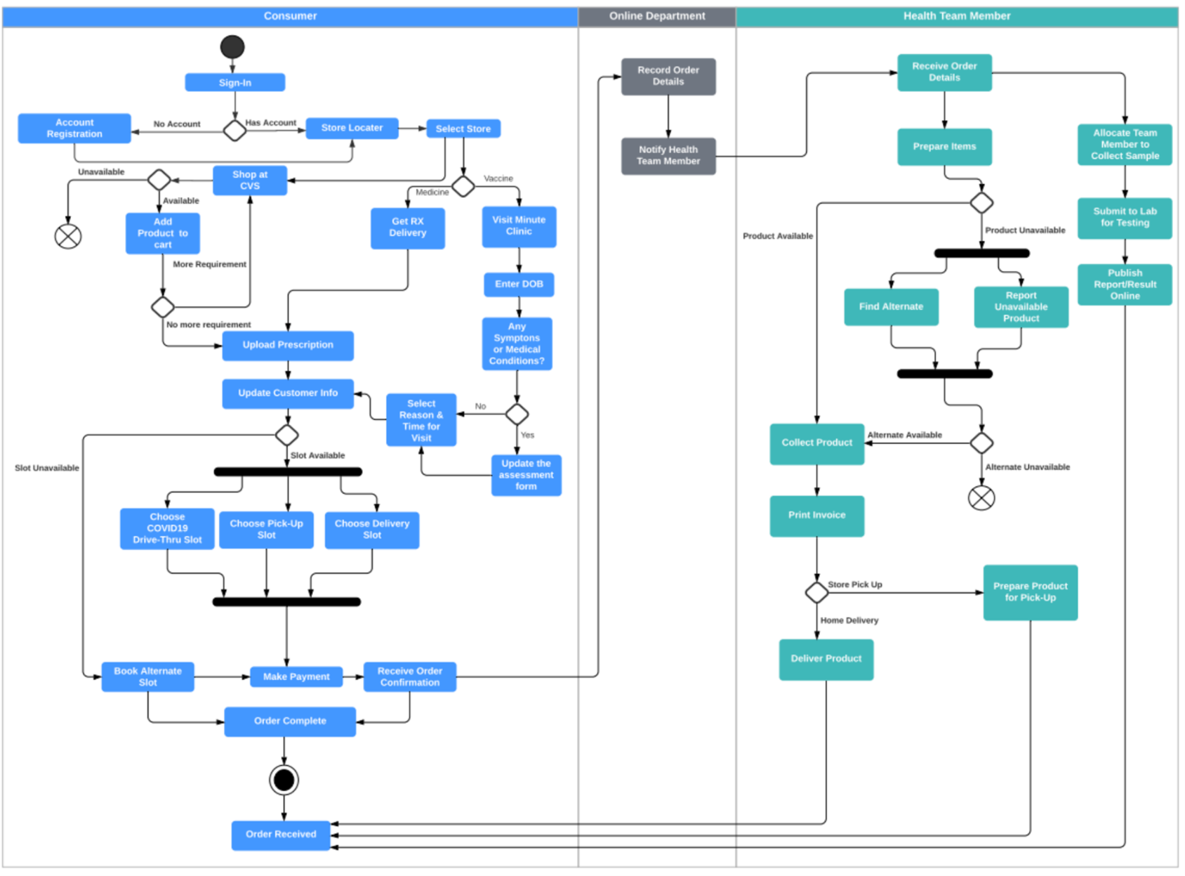
As-Is Business Process Map
5
Notes:
Rakesh

Slide 6
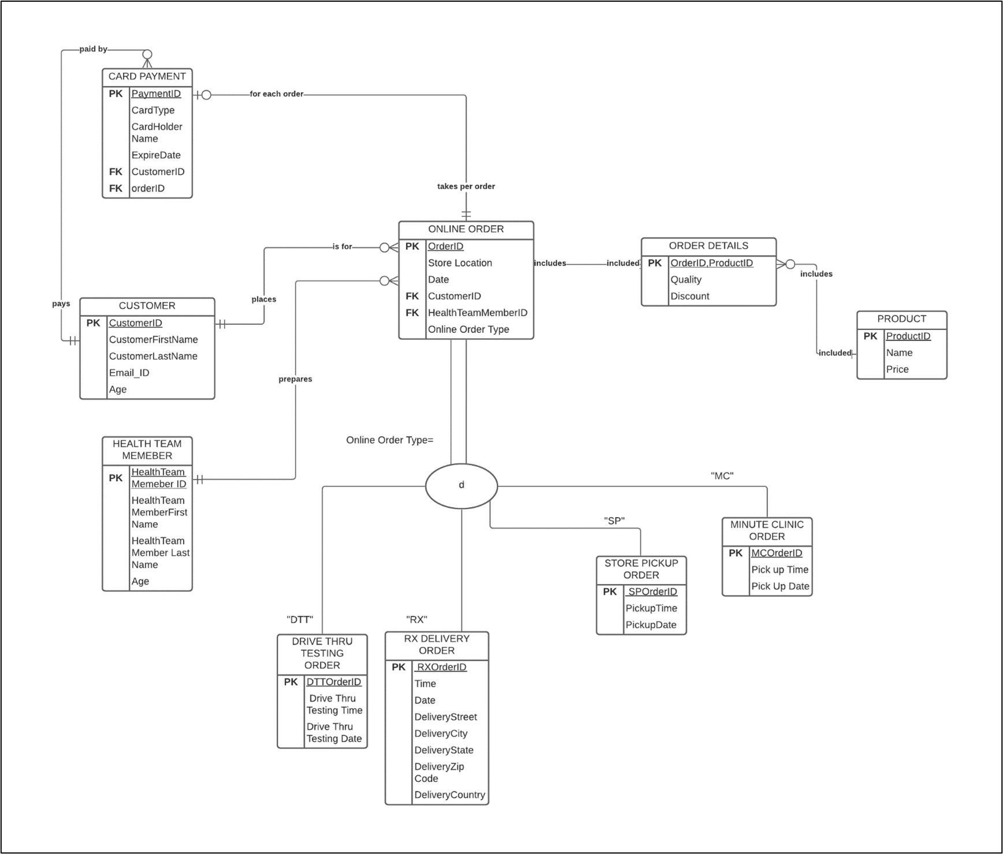
As-Is ERD
6
Notes:
Rakesh

Slide 7

Section II – IT Based Proposed Solution
IT-Based Solution
Leveraging the existing system to add the capability to provide covid-19 vaccines thru the current drive-thru system.
*TO-BE Business Process Map,TO-BE Database (ERD), and DB Entity Matrix 3NF Relational Schema are shown on the next slides
7
Notes:
Sohila

Slide 8
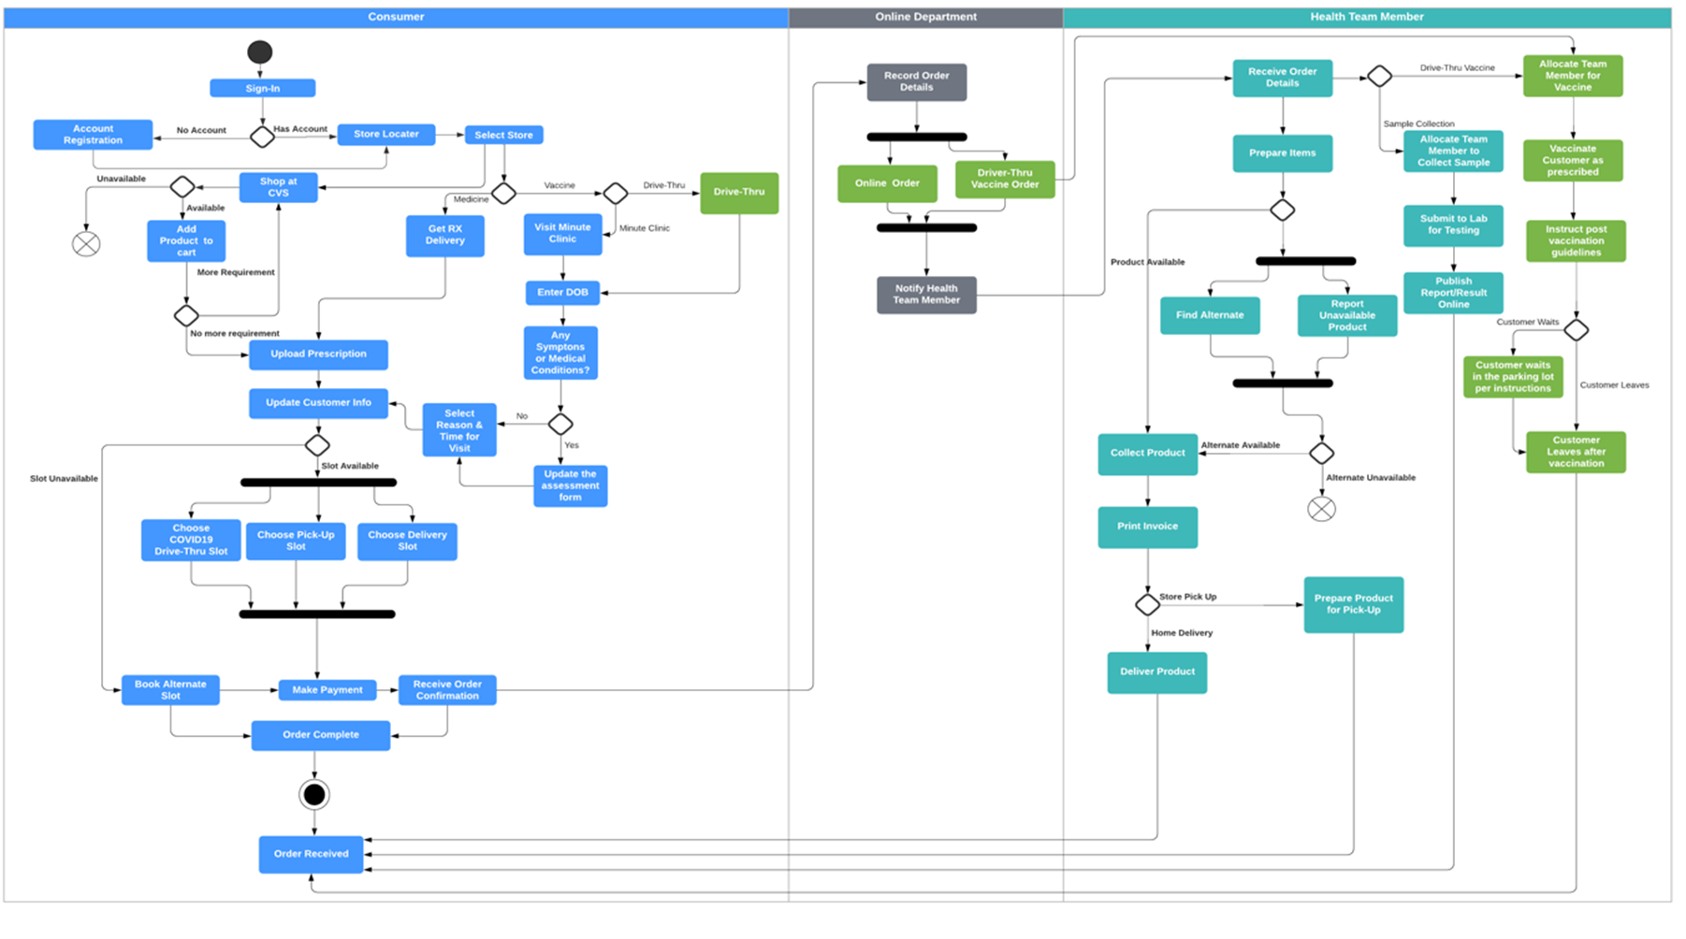
Proposed Business Process Map
8
Notes:
Sohilla

Slide 9
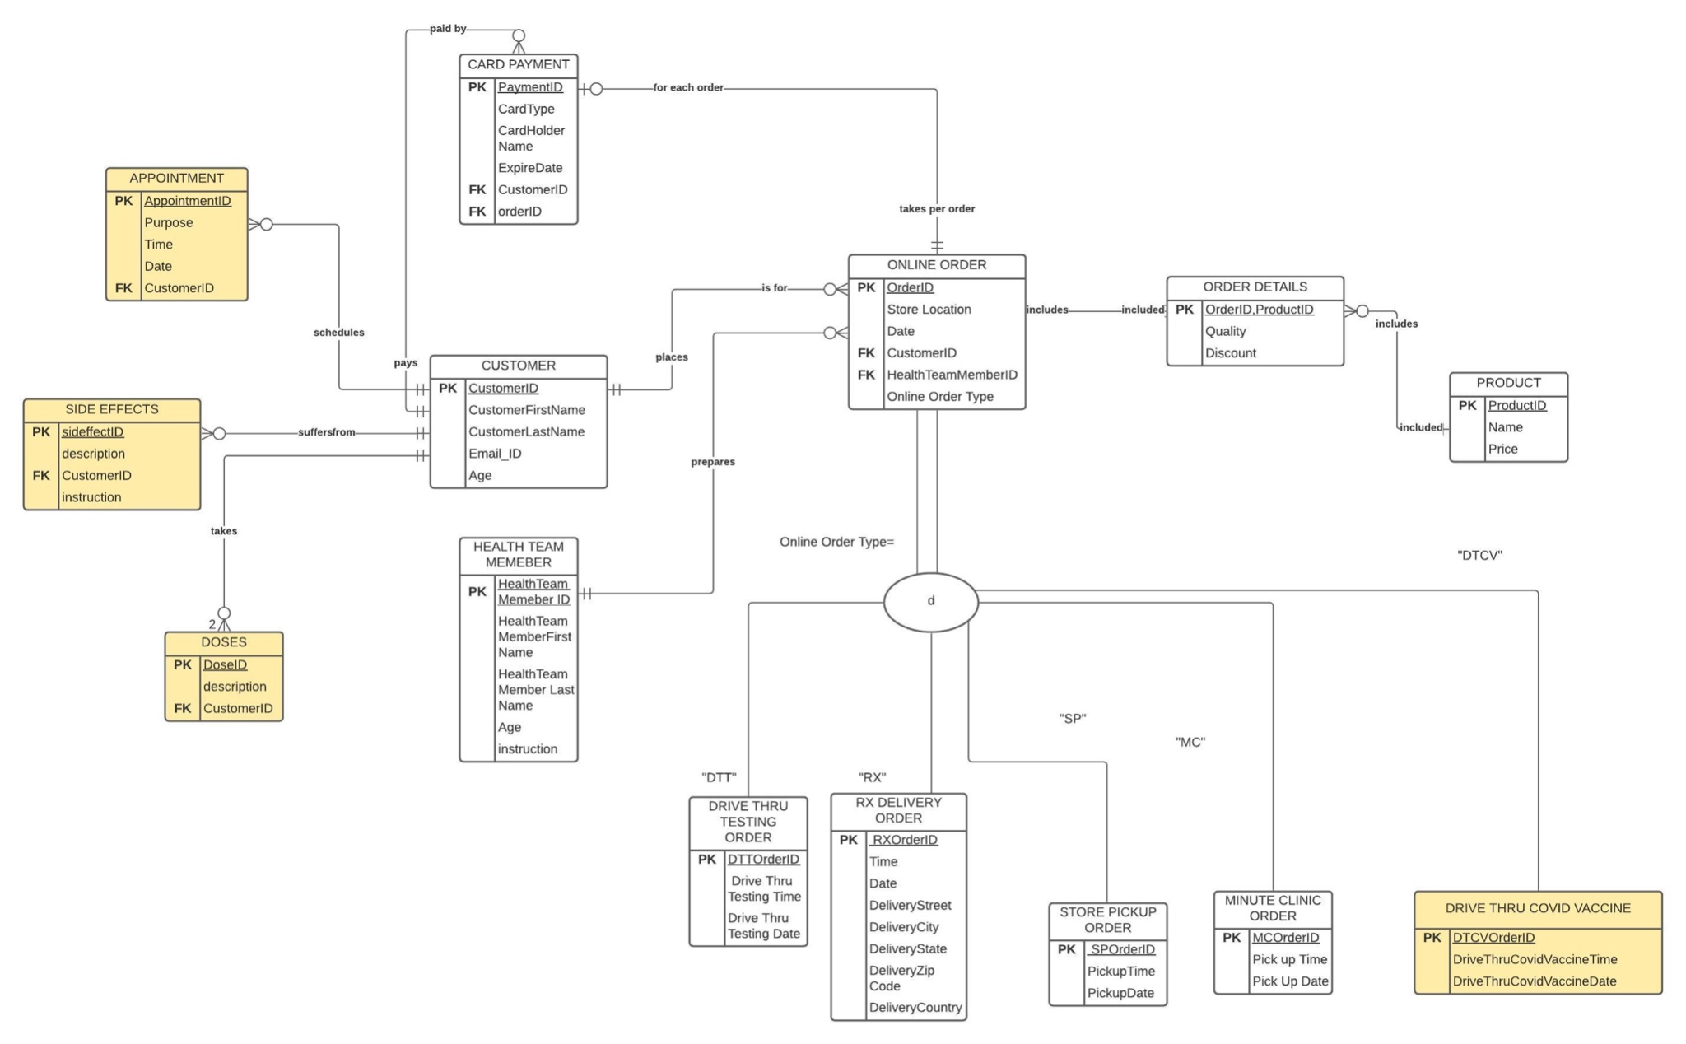
To Be ERD
9
Notes:
Sohilla

Slide 10
Data Entity Matrix
Data Entity Types Business Functions | Online Order | Customer | Product | Card_Payment | Order_Details | Drive_Thru_COVID_Vaccine | Drive-Thru_Testing_Order | RX_Delivery_Order | Store_Pick-up_Order | Minute_Clinic_Order | Health_Team_Member
Account Authorization | X | X
Mode of Delivery | X | X |  |  | X | X | X | X | X | X
Order Fulfilment | X | X | X |  | X | X | X | X | X | X | X
Pickup-Time Preference |  | X |  |  | X
Delivery-Time Preference |  | X |  |  | X
Payment | X | X | X | X | X
Wait Time |  | X | X |  | X |  |  |  |  |  | X
Appointment Availability |  | X |  | X |  | X |  |  |  | X | X
Sample Collection |  | X |  |  |  |  | X |  |  |  | X
Health Form |  | X |  |  |  | X | X |  |  | X
10
Notes:
Sohila

Slide 11
3NF Relation Schema
CARDPAYMENT(PaymentID ,CardType, CardHolderName, ExpireDate,CustomerID,OrderID)
CUSTOMER(CustomerID, CustomerFirstName,CustomerLastName,EmailID,Age)
HEALTHTEAMMEMBER(HealthTeamMemberID, HealthTeamMemberFirstName,HealthTeamMemberLastName, Age)
ONLINEORDER(OrderID, StoreLocation,Date,CustomerID,HealthTeamMemberID,OnlineOrderType)
DRIVETHRUTESTINGORDER(DTTOrderID, DriveThruTestingTime,DriverThruTestingDate)
RXDELIVERYORDER(RXOrderID, Time,Date,DeliveryStreet,DeliveryState,DeliveryZipCode,DeliveryCountry)
STOREPICKUPORDER(SPOrderID, PickupTime,PickupDate)
MINUTECLINICODER(MCOrderID, PickupTime, PickupDate)
DRIVETHRUCOVIDVACCINE(DTCVOrderIDDriveThrouCovidVaccineTime, DriveThrouCovidVaccineDate)
PRODUCT(ProductID,Name,Price)
ORDERDETAILS(OrderID, ProductID ,Quality,Discount)
11
Notes:
Sohila

Slide 12
Section III – Database Implementation
Table Creation Samples:
CREATE TABLE CVSCustomer(
CustomerID INT(3) NOT NULL,
CustomerFirstName VARCHAR(100) NOT NULL,
CustomerLastName VARCHAR(100) NOT NULL,
EmailID VARCHAR(100) NOT NULL,
Age INT(3) NOT NULL,
CONSTRAINT CVSCustomer_pk PRIMARY KEY(CustomerID));
CREATE TABLE HealthTeamMember(
HealthTeamMemberID INT(3) NOT NULL,
HealthTeamMemberFirstName VARCHAR(100) NOT NULL,
HealthTeamMemberLastName VARCHAR(100) NOT NULL,
Age INT(3) NOT NULL,
CONSTRAINT HealthTeamMember_pk PRIMARY KEY(HealthTeamMemberID));
CREATE TABLE OnlineOrder(
OrderID INT(3) NOT NULL,
StoreLocation VARCHAR(100) NOT NULL,
Date DATE,
CustomerID INT(3) NOT NULL,
HealthTeamMemberID INT(3) NOT NULL,
CONSTRAINT OnlineOrder_pk PRIMARY KEY(OrderID),
CONSTRAINT OnlineOrder_fk1 FOREIGN KEY (CustomerID) REFERENCES CVSCustomer(CustomerID),
CONSTRAINT OnlineOrder_fk2 FOREIGN KEY (HealthTeamMemberID) REFERENCES HealthTeamMember(HealthTeamMemberID));
CREATE TABLE DriveThruTestingOrder(
DTTOrderID INT(3) NOT NULL,
DriveThruTestingTime TIME ,
DriveThruTestingDate DATE,
CONSTRAINT DriveThruTestingOrder_pk PRIMARY KEY (DTTOrderID));
Insert Data:
INSERT INTO CVSCustomer(CustomerID,CustomerFirstName, CustomerLastName, EmailID, Age) VALUES
(1,'James','Smith','jsmith@hotmail.com',45),
(2,'Mary','Miller','marym9@gmail.com',34),
(3,'John','Williams','jowilliams@outlook.com',28),
(4,'David','Martinez','martinezd@hotmail.com',26),
(5,'Jenny', 'Wilson' ,'jenwilson@yahoo.com',42),
(6,'Jessica','Davis','jessicad@gmail.com',51),
(7,'Richard','Clark','clarkrichard@hotmail.com',48),
(8,'Charles','Jones','cjones@yahoo.com',33),
(9,'Joseph','Rogers','rogersj@gmail.com',27),
(10,'Charles','Bennett','cb@zoho.com',60),
(11,'Sara','Andersen','sandersen82@gmail.com',41),
(12,'Diana','Bates','diana123@hotmail.com',18),
(13,'Elizabeth','Goodwin','saragoodwin@sohu.com',29),
(14,'Susan','Bryant','susanbry8@gmail.com',26),
(15,'Robert','Terry','rterry@gmail.com',19),
(16,'Rachel','Green','rachgreen@gmail.com',22),
(17,'Sarah','Bass','sarahbass203@gmail.com',24),
(18,'Joey','Tribbiani','joeyt@outlook.com',61),
(19, 'Romain','Jones','romainjones@gmail.com',42),
(20, 'Chandler','Bing','chanbing@yahoomail.com',30),
INSERT INTO `DriveThruTestingOrder` (`DTTOrderID`, `DriveThruTestingTime`, `DriveThruTestingDate`) VALUES ('111', '11:35:03', '2021-03-09'), ('112', '12:40:03', '2021-03-09'), ('113', '10:34:03', '2021-03-11'), ('114', '10:38:03', '2021-03-12'), ('115', '10:38:08', '2021-03-13'), ('116', '10:38:12', '2021-03-14'), ('117', '13:33:03', '2021-03-15'), ('118', '14:28:03', '2021-03-16'), ('119', '14:08:52', '2021-03-17'), ('120', '14:13:52', '2021-03-18'), ('121', '14:16:52', '2021-03-19'), ('122', '14:58:52', '2021-03-22'), ('123', '10:08:52', '2021-03-23'), ('124', '11:08:52', '2021-03-24'), ('125', '12:08:52', '2021-03-25'), ('126', '11:32:52', '2021-03-26'), ('127', '13:18:52', '2021-03-27'), ('128', '13:36:28', '2021-03-28'), ('129', '12:16:25', '2021-04-05'), ('130', '12:20:37', '2021-04-07');
12
Notes:
Anisha

Slide 13
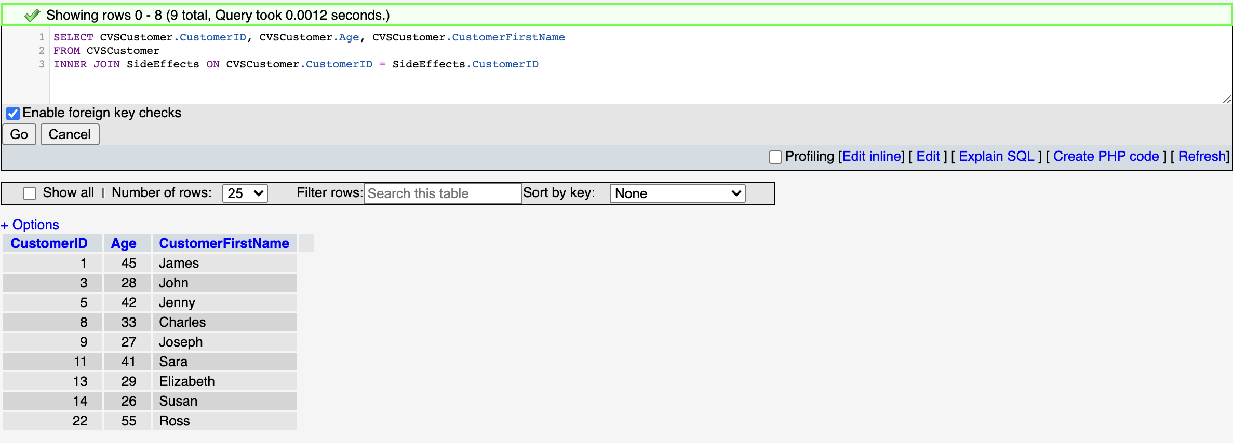
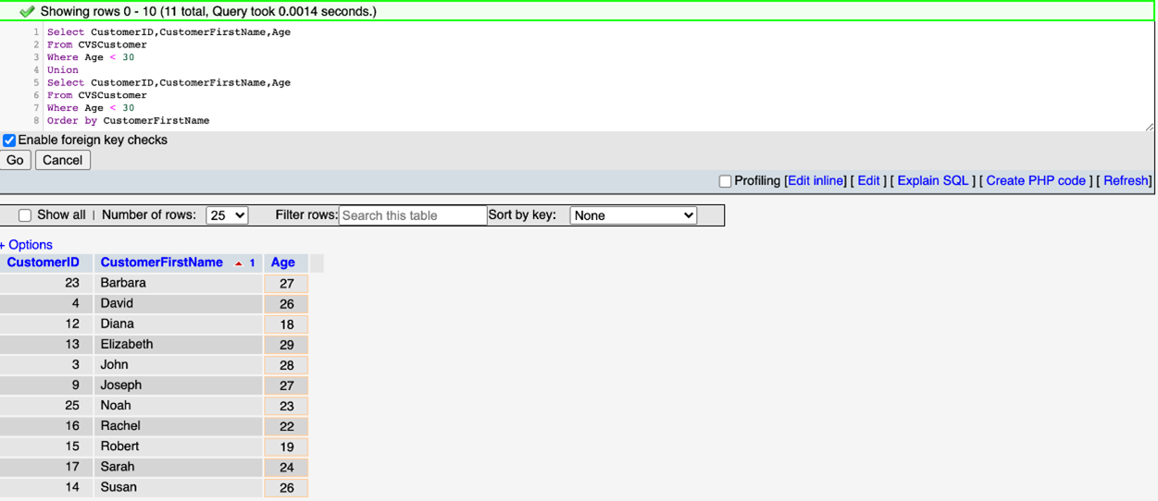
SQL Queries 1
13

Slide 14
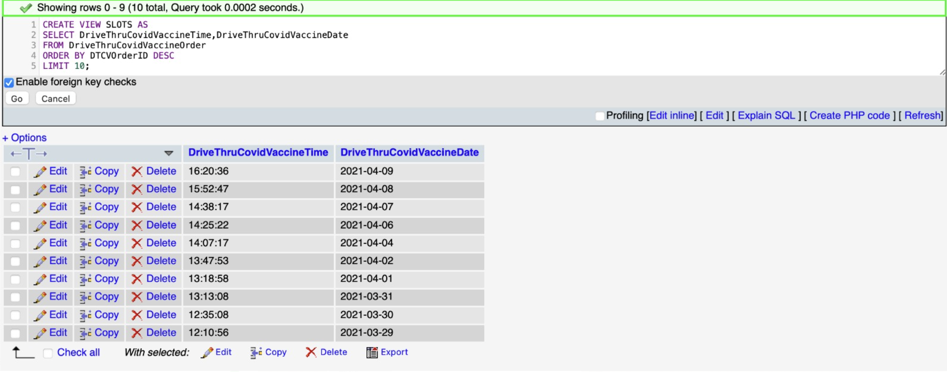
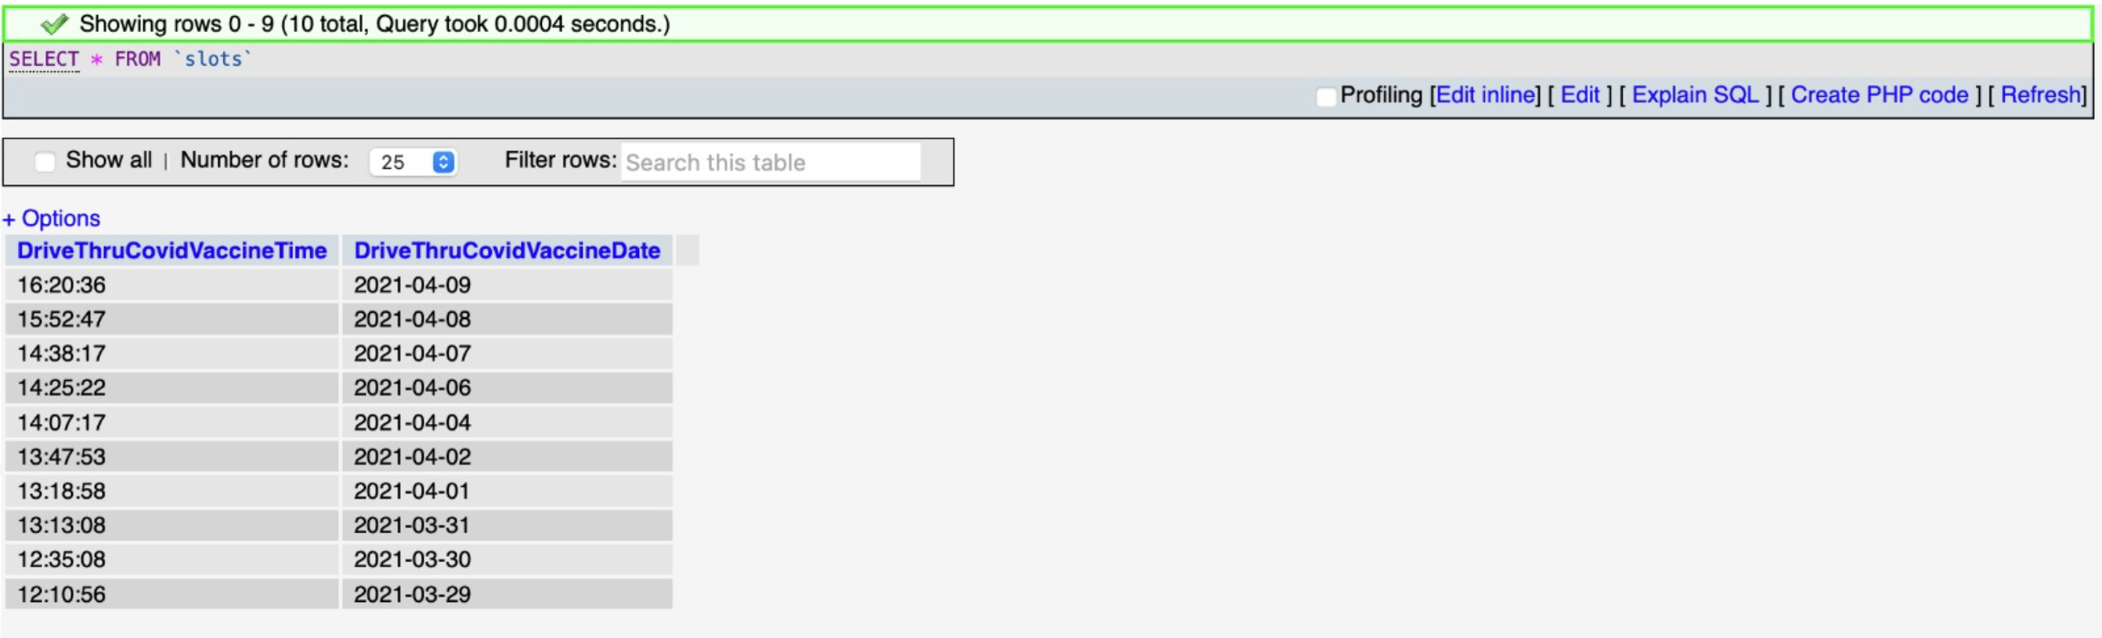
SQL Queries 2
14

Slide 15
Conclusion
Outcome
Reducing :
Dependency
Time
Others:
Maximizing Vaccination Rate
Contactless to adhere to
social distancing standards
Limitation
Technology Independence
Wait Time
Discussion
Q & A
15

